Slide 1

Major Project Presentation
Topic: An Online E-Bookshop and E-Learning Project Combining the Features of an Online Bookstore with an E-Learning Platform
Presented by:
Ajay Kumar Singh - 27600122119 Himansu Kumar Singh - 27600122031
Aman Singh - 27600122120
Saksham Gupta - 27600122181 Rishu Raj - 27600122186
Supervisor: Mr. Jyoti Priyo Khanra
Department Of Computer Science & Engineering
Budge Budge Institute Of Technology, Kolkata
July 15 , 2026

Slide 2
OBJECTIVE
The main objective of our project (Eduverse) is to develop a unified digital platform that combines an online e-book store and an e-learning system to make
education more accessible, interactive, and engaging.
The platform aims to provide students, teachers, and readers with a seamless experience where they can purchase and read books, enroll in online courses, and track their learning progress.
Eduverse seeks to promote digital literacy and bridge the gap between traditional learning and modern technology through a user-friendly and scalable web solution.

Slide 3
Problem Statement
In today’s world, online learning and digital reading platforms are increasing rapidly, but most of them are separated — e-learning platforms focus only on video-based education, while e-book platforms only provide reading material.
Students and readers often need to switch between multiple applications to access study materials, courses, and books. This causes inconvenience, data loss, and a lack of a unified learning experience.
Additionally, traditional education systems still depend heavily on physical books and offline classes, making learning less flexible, especially for remote learners.

Slide 4
Key Features
Eduverse has been designed with multiple interconnected modules that together form a complete digital learning and reading ecosystem.
Each module focuses on a specific functionality to enhance the user experience and ensure smooth operation of the platform — from user authentication to course management and e-book purchases.
User Authentication, E- Book Store, E- Learning, Progress Tracking, Admin Panel, Search & Filtering, Payment Integration, Feedback & Review, Notification, and Responsive UI Modules.

Slide 5
Technology Stack
Eduverse uses a modern and robust technology stack to ensure smooth performance, scalability,and user-friendly experience.The frontend is built with React.js
The backend uses Node.js to handle APIs, authentication, and business logic.
The database uses My SQL for secure and efficient data storage.
Frontend: React.js Backend: Node.js Database: MySQL .

Slide 6
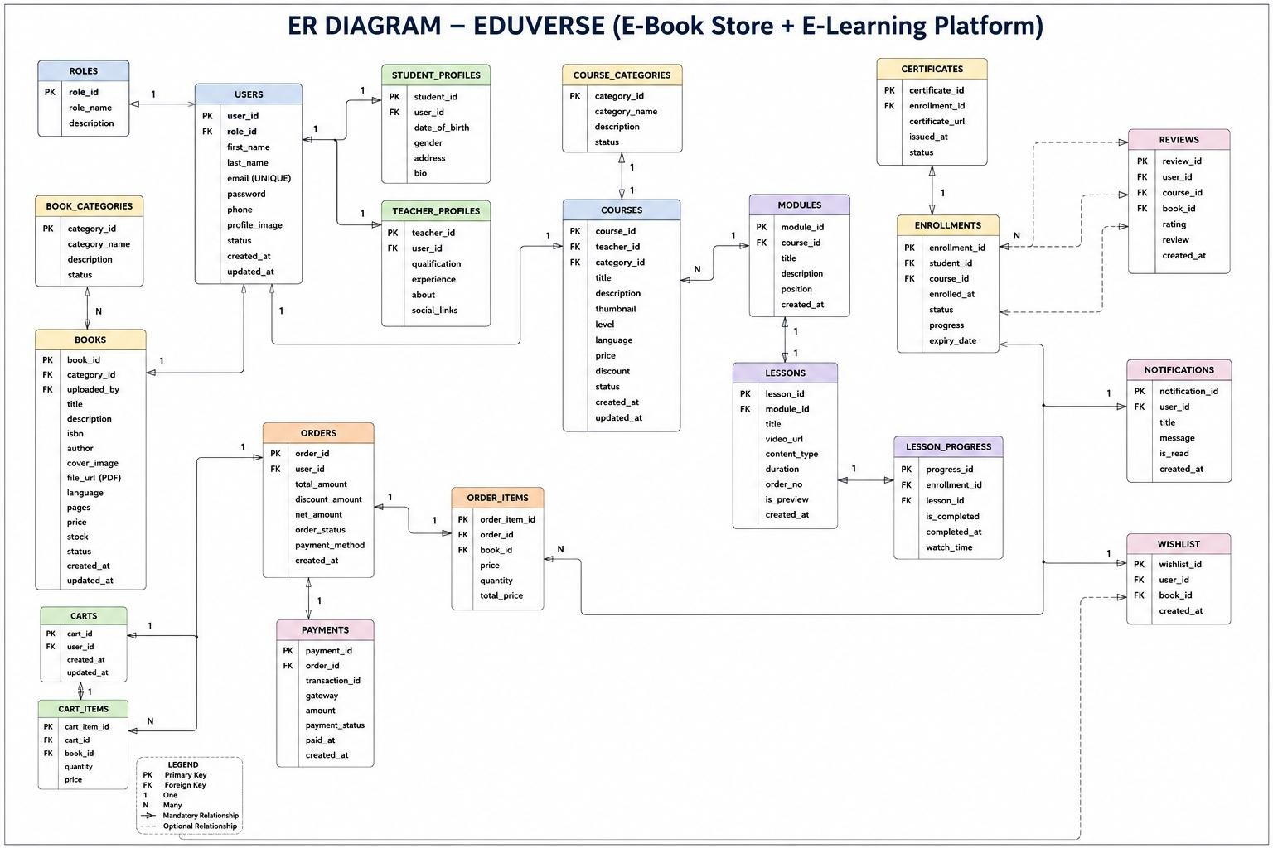
ER Diagrams

Slide 7
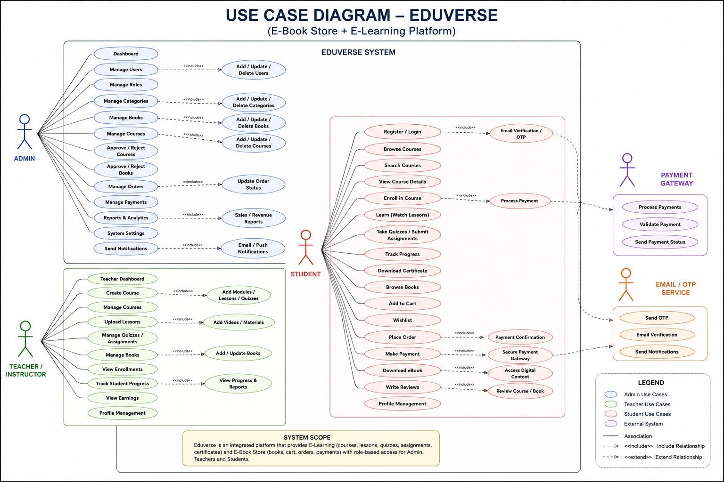
UseCase Diagrams

Slide 8
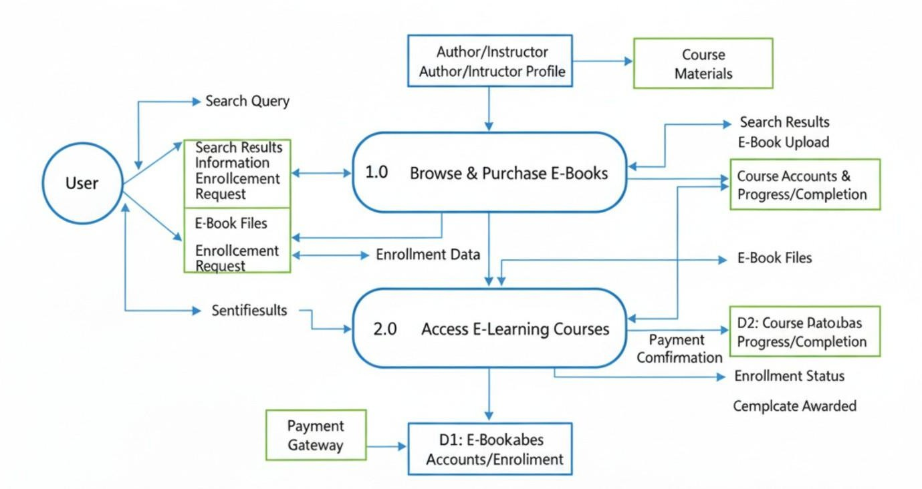
Work Flow / Data Flow

Slide 9
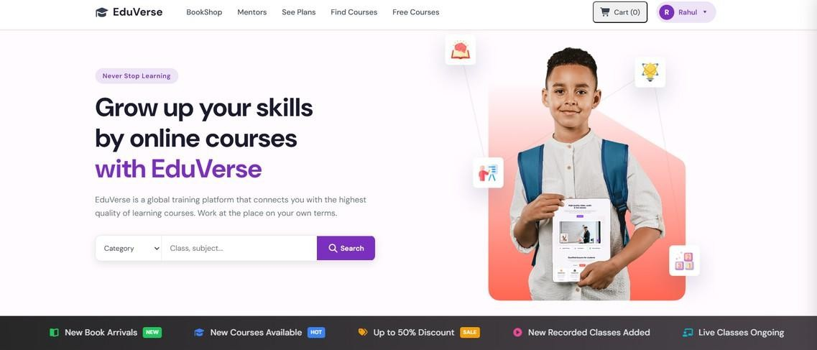
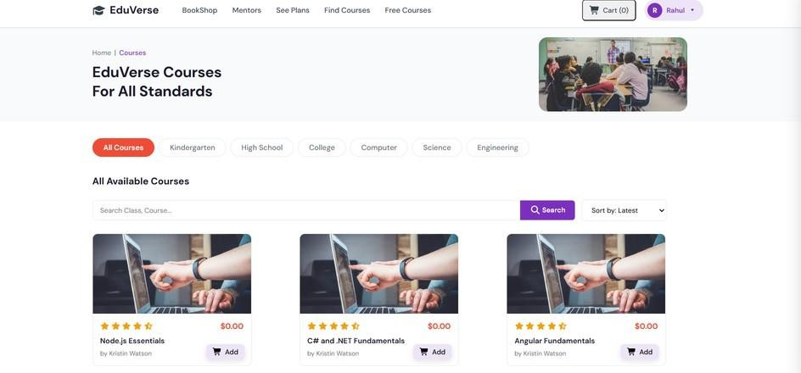
Student’s
Dashboard:-

Slide 10
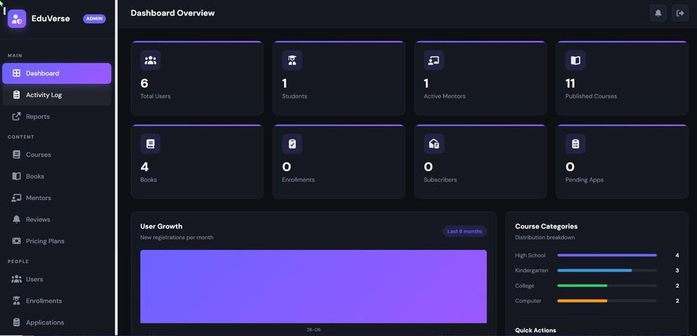
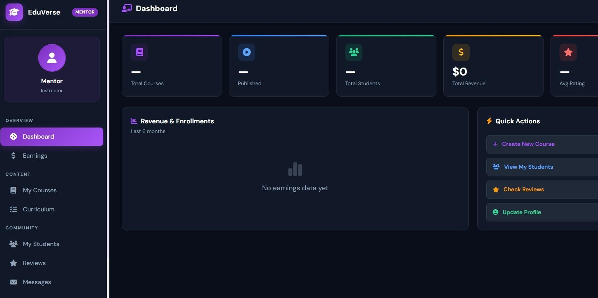
Admin’s Dashboard
Mentor/Teacher’s
Dashboard

Slide 11
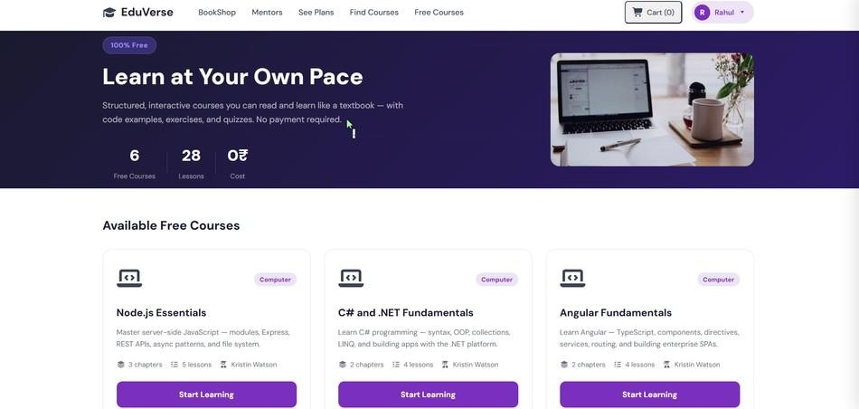
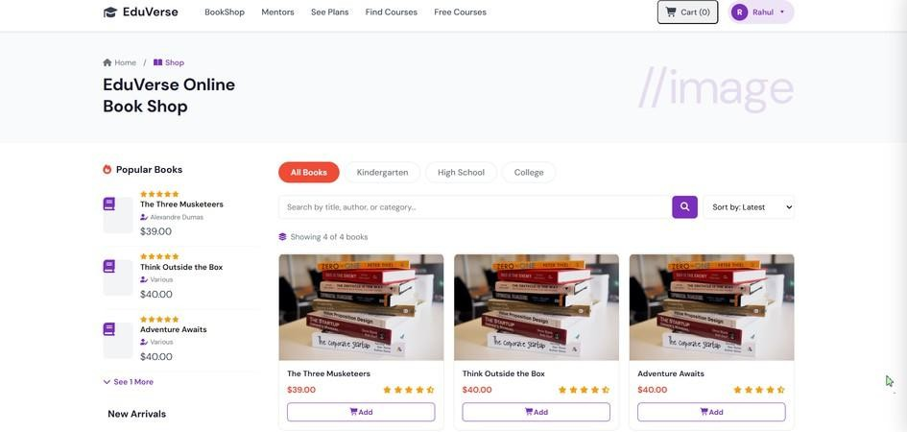
Courses
Books Shop

Slide 12
Future Scope / Enhancements
AI Tutor: Personalized guidance & real-time doubt resolution.
Advanced Analytics: Track student progress, engagement, and learning patterns
Intelligent Chatbots: Instant support for queries, FAQs, and course navigation.
Payment Integration: Secure in-app payments for courses & e-books. Gamification & Rewards: Badges, leaderboards, and achievement tracking.

Slide 13
References
YouTube: For practical tutorials and implementation guidance.
Google: For exploring development references and troubleshooting.
Official Documentations: React, Node.js and My SQL, for accurate technical implementation.

Slide 14
Conclusion
Complete Learning Ecosystem: Eduverse integrates e-books, courses, quizzes, and interactive tools in a single platform for a seamless learning experience.
Enhanced User Engagement: Personalized dashboards, progress tracking, bookmarks,
and highlights make learning interactive and motivating.
Accessibility & Convenience: Responsive design ensures smooth usage across desktop, tablet, and mobile, allowing learning anytime, anywhere.
Designed for All Learners: Supports students, instructors, and lifelong learners with collaborative features like forums and peer discussions.
Future-Ready & Scalable: Plans for AI tutors, advanced analytics, intelligent chatbots, payment integration, and gamification make Eduverse adaptable and innovative.

Slide 15


